Slide 1
Central Africa forest initiative
Encouraging Innovative Ways and Means for Industrial Collaboration
GLSTF 2024

Slide 2
Summary
Encouraging Innovative Ways and Means for Industrial Collaboration
CAFI overview
CAFI private sector facility
Investment framework for the forestry sector
Existing pipeline
KPIs and incentive framework

Slide 3
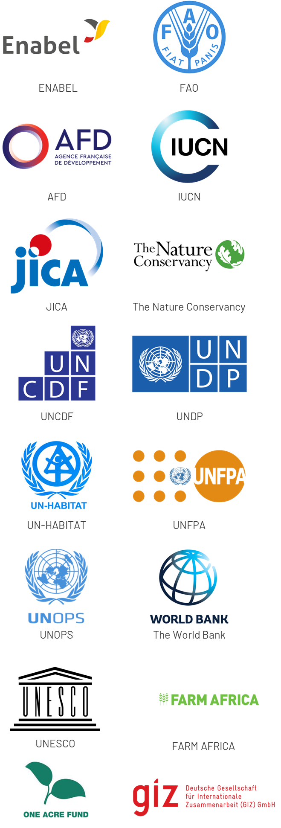
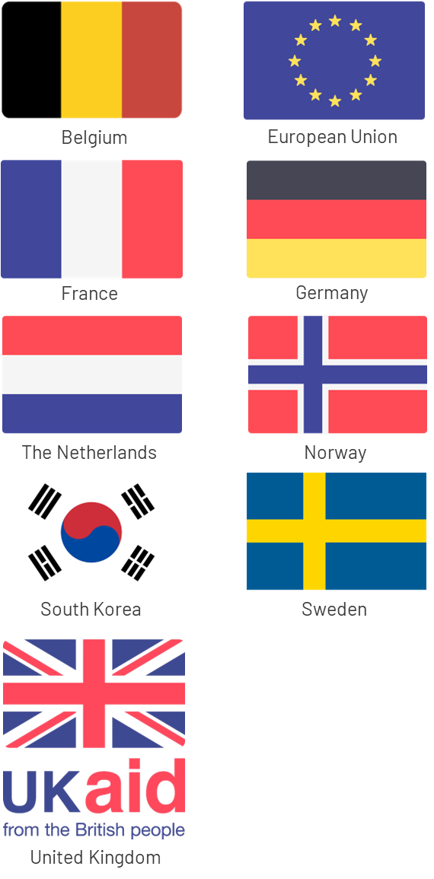
CAFI: a dedicated Initiative and trust fund created to address the specific challenges of the region in 2015
Partner countries
Implementing organizations
Donor countries

Slide 4
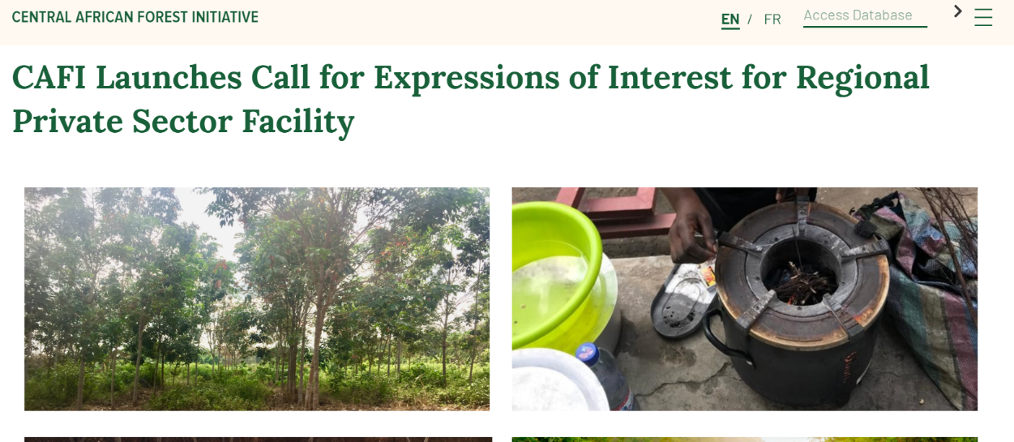
https://www.cafi.org/cafi-launches-call-expressions-interest-regional-private-sector-facility

Slide 5
CAFI PRIVATE SECTOR FACILITY
INVESTMENT FRAMEWORK FOR THE FORESTRY SECTOR
01
SOUGHT OUTCOME
Creation/expansion of forest industries which create added value and jobs through transformation of timber sourced from sustainably managed and legal forests concessions
Forest certification
legality -> sustainability
Reduced impact logging
Use of sawmill waste (biochar, cogeneration, other)
Timber plantations
Transformation and value added -> factories and equipement
02
03
04

Slide 6
CAFI private sector facility USD $100M through 3 financial instruments
Preparation grants
Blended finance
Performance-based payments
Support for companies developing projects
Concessional loans, guarantees
Payment for Environmental Services
e.g. feasibility studies​
e.g. concessional loans for OPEX or CAPEX
e.g. payment $/ha achieving and maintaining certification

Slide 7
Pipeline with Existing partners in the Central African timber industry
Feasibility studies underway investment proposals will be ready by end 2024:
Common Fund for Commodities
INTERHOLCO
ARISE IIP
CIB-OLAM
Support also provided to ATIBT
Financial Instruments | Amount (USD millions)
Prep Grants | 2.80
Blended finance | 95.66
Payment for environmental services | 58.70
Total funding requested from CAFI | 156.66
Co-financing (leverage) | 108.00
Leverage ratio | 0.69
Total funding for projects in the pipeline | 264.98

Slide 8
KPIs: towards a framework for the logging sector
Incentives increase with the generation of environmental services
Sustainable Management Certification
(FSC or PAFC)
Environmental Services Certification (e.g. FSC)
RIL-C (tCO2)
Legality Certification
High integrity

Slide 9
The sustainability-linked loan: a performance-based financial instrument to scale-up support to the timber indusry
Improvement in Borrowing Terms: SLL will come with flexible terms that are tied to the borrower’s ability to achieve the predetermined performance targets. If borrower meets the targets, CAFI’s performance-based grant resources are used to erase the debt or reduce the interest rate. Failure to meet the targets will result in the normal lending costs (regular pricing).
Term of the loan and monitoring period. Preliminarily we propose a 10-year performance period to monitor the KPIs for each loan (e.g., 2026 to 2035). During this period, every year the Key Performance Indicators (KPI) are checked by May, and financial impact is provided in the following two semesters.
KPIs and Performance Targets: critical component of the SLL. These will need to be carefully defined for each types of investments and include proxies for reductions in greenhouse gas emissions or removals and biodiversity conservation.
Third-Party verification/certification: will establish trust between the borrower and the lender and provide assurance that the sustainability targets are being accurately assessed and reported.
CAFI
Performance-based
Grants
FInancial Institutions
(e.g. CFC)
Dev. Bank Loan
(regular pricing)
Debt pardoned /Interest Rate
Reductions
Borrower
(Timber company)
NO
YES
Meet the KPI?
Notes:
Most of important part of this is to comply with KPI

Slide 10
Merci
CAFI Secretariat
Chemin des Anémones 11-13
1219 Châtelaine Switzerland
secretariatcafi@gmail.com

